Slide 1
Git Basics
A Modern Version Control System
Notes:
Version control systems are a category of software tools that help a software team manage changes to source code over time.
Track every modification
Concurrent working from conflicting

Slide 2

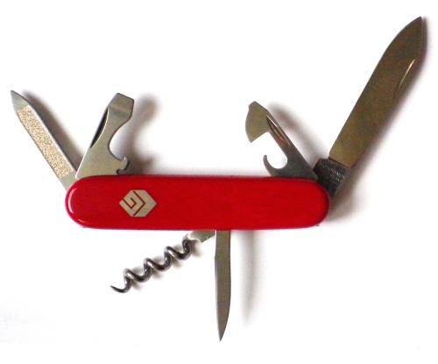


40 Years of version control
Subversion (2001)
SCCS & RCS (1970s)
Git (2005)
Image © TheSun.au
CVS (1986)
Notes:
SCCS: source code control system
RCS: revision control system
CVS: concurrent version system
Rather than have only one single place for the full version history of the software, every developer’s working copy of the code is also a repository that can contain full history of all changes.

Slide 3
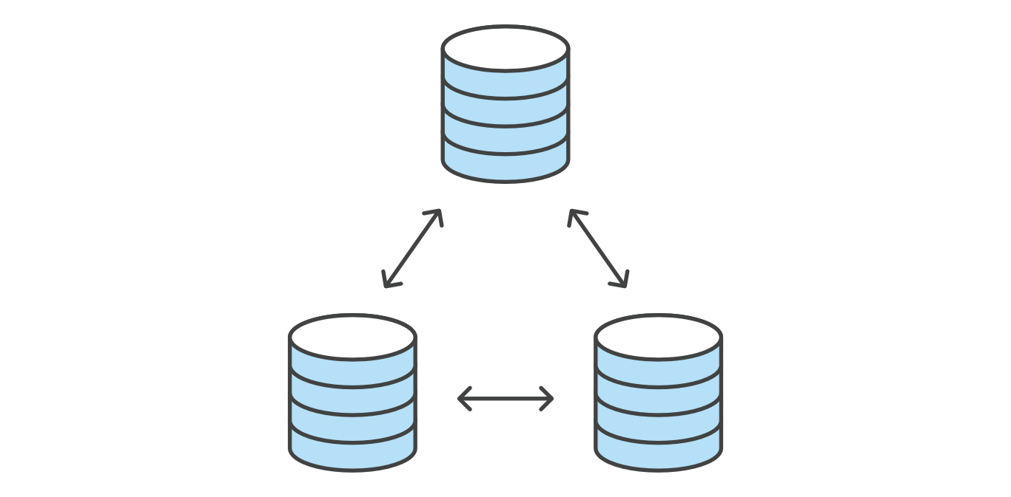
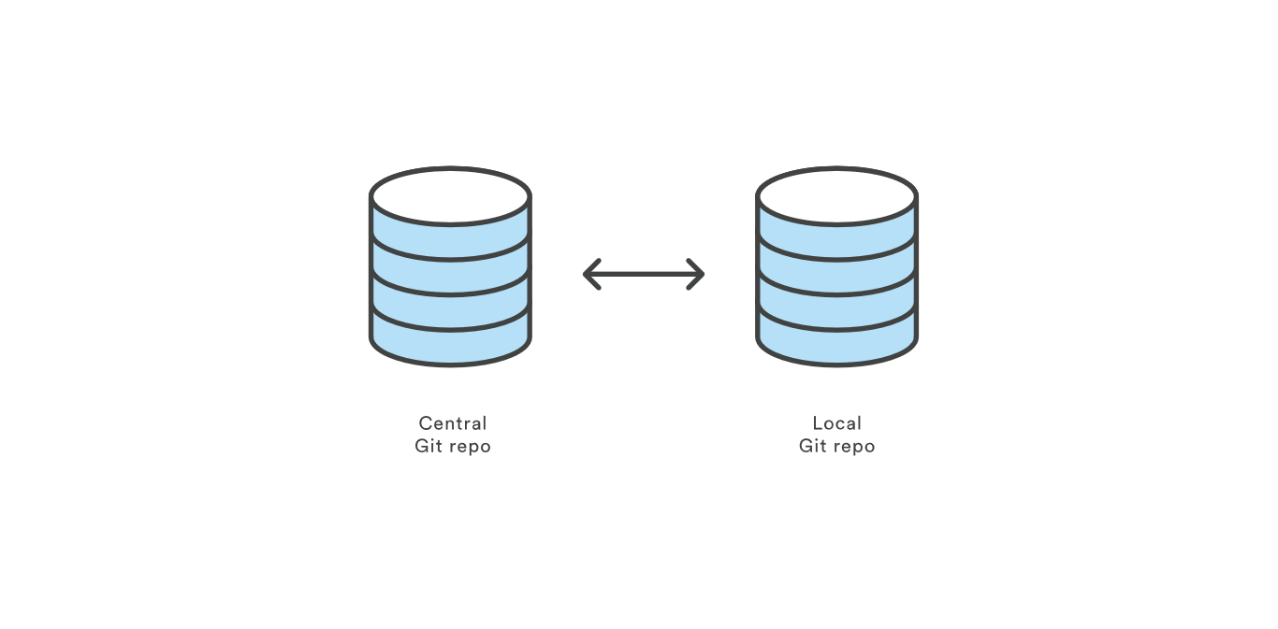
Git
Notes:
Communicate with remote repo
Collaboration with each developer: own entire copy of the repo, its local history and branch structure
Connection with other by pushing and pulling

Slide 4
Setting up a repository
git init
git clone
git config
Notes:
Repository: Collection of commits, branches, and tags (named commits).
Can be local or remote (ex. Github).
Can have different branches
branches can have a different commit history from the local version

Slide 5
The Basic Workflow
Create a new local repository with the specified name
git init [project-name]
Clone the remote repository to your machine (only needs to happen once)
git clone [url]
Configure your git installation
git config –global user.name [name]
git config –global user.email [email]

Slide 6
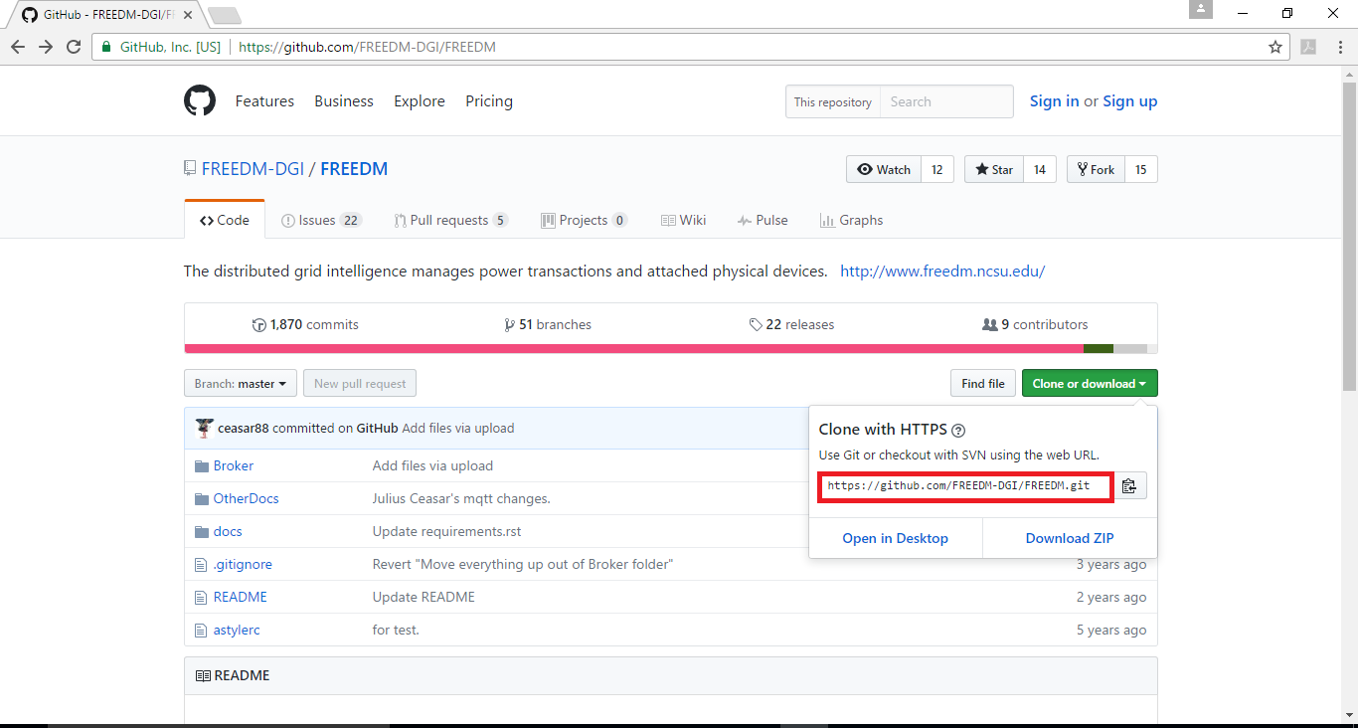

Slide 7
Using branches
git branch
git checkout
git merge

Slide 8
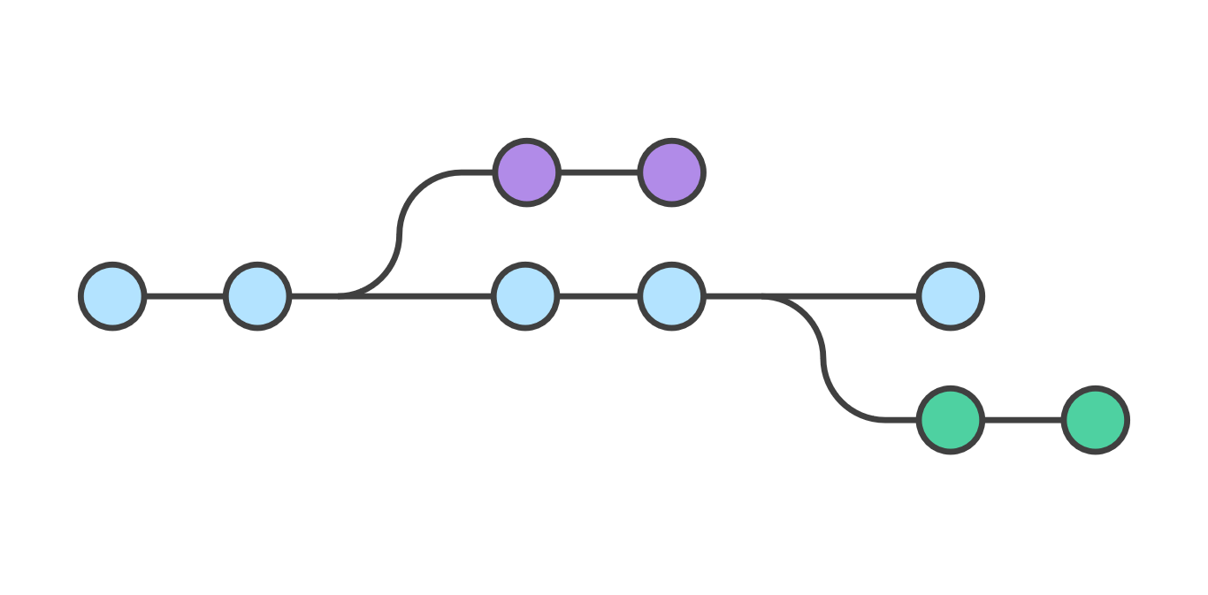
Branches
Development master vs. branches
Creating branch is cheap!
switch among branches: checkout
Separate commit histories per branch
Merge branch back into master
...or with pushing branch changes
Most branches eventually die
branch per feature
Notes:
Branch - A path of development. Describes a path of commits.
Master: The main branch of the project
HEAD - The most recent commit of a branch

Slide 9
Creating new features without disrupting working code
To work on a new feature, create new branch just for that feature
many features can be in progress at same time
Use branch only for changes needed for this feature, then merge into master
Back out this feature ⬄ undo this merge
In well-factored app, 1 feature shouldn't touch many parts of app
Notes:
Worse if long time; branches shouldn't be long-lived in agile development

Slide 10
Create A New Branch For Your Feature
create a new branch
> git branch newBranchName
switch to the new branch
> git checkout newBranchName
Or: create and checkout to the new branch.
> git checkout -b newBranchName

Slide 11
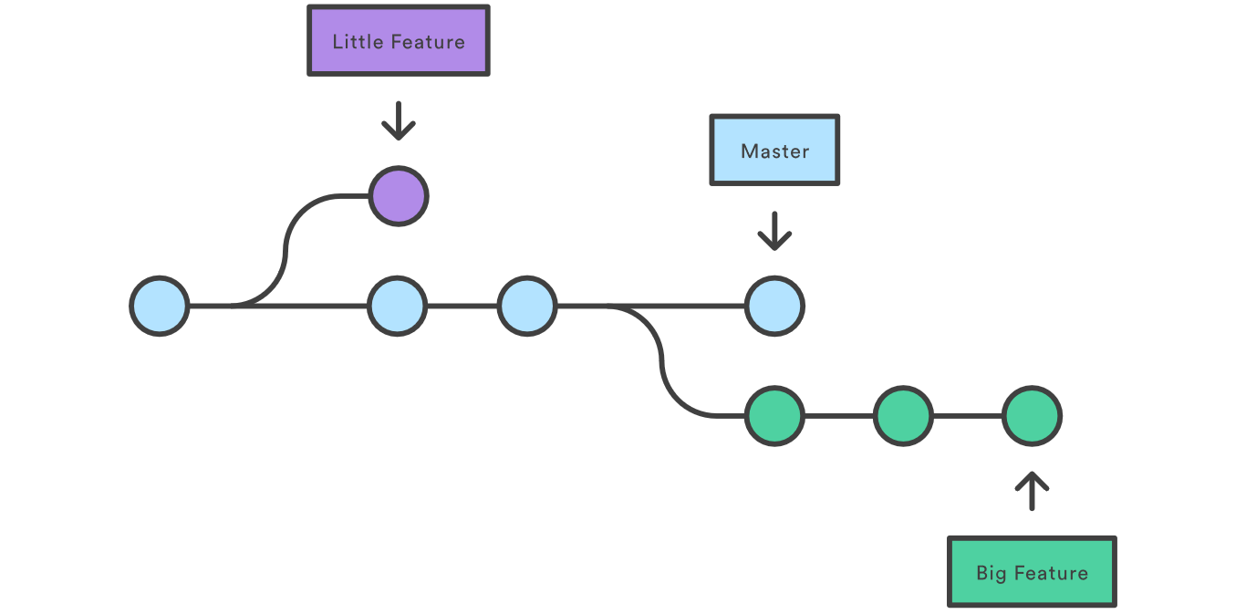
Create branches
Notes:
This makes sure that unstable code is never committed to the main code base, and it gives you the chance to clean up your feature’s history before merging it into the main branch.

Slide 12
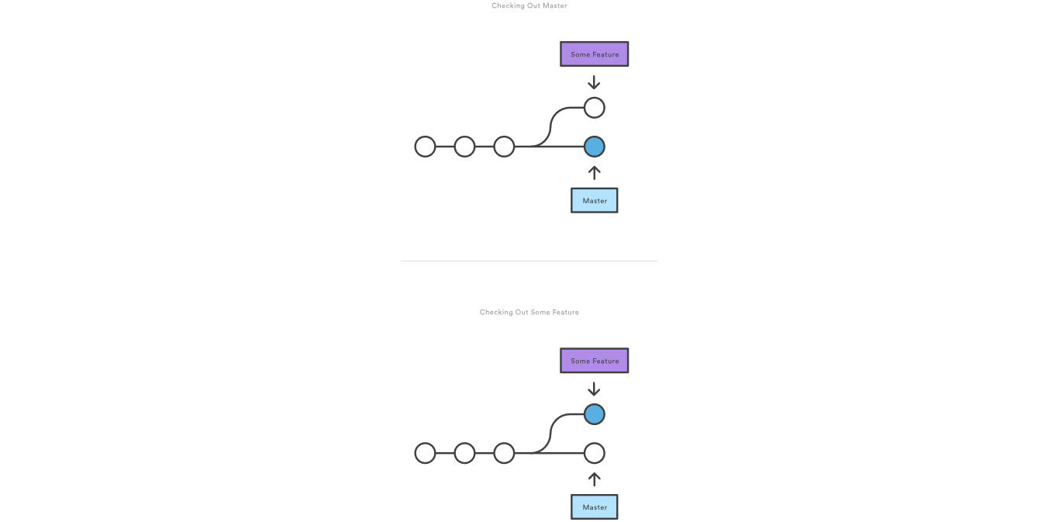
Checkout Branch
Notes:
You can work on multiple features in a single repository by switching between them with git checkout.

Slide 13
git merge
Putting a forked history back together again
Merge to the current branch
The target branch will be completed unaffected
Serval distinct algorithms to merge
Notes:
lets you take the independent lines of development created by git branch and integrate them into a single branch.

Slide 14
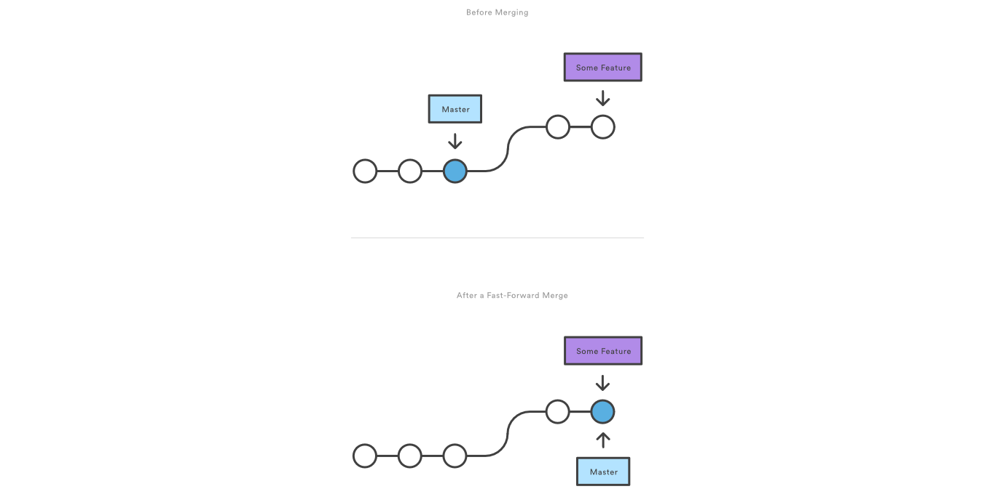
A Fast-Forward Merge
Notes:
when there is a linear path from the current branch tip to the target branch

Slide 15
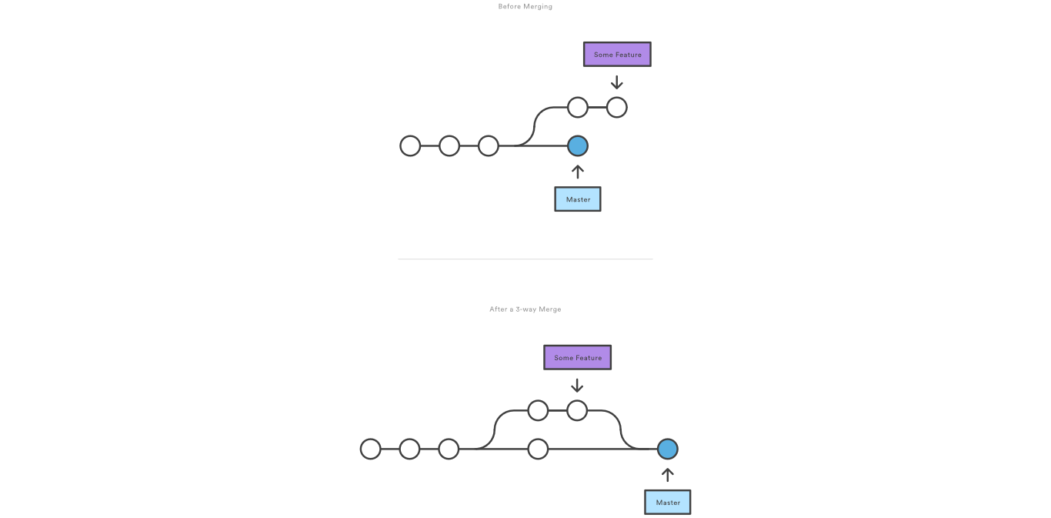
3-way merge
Notes:
if the branches have diverged

Slide 16
Merging Bug-fixes
Combine your development branch with master.
Switch Back To Your Development Branch:
> git checkout feature
Then, merge in master
> git merge master
If master hasn't changed, nothing bad should happen here. If it has, you might get merge conflicts
Notes:
Merge the master branch into the feature branch

Slide 17
Resolving Conflicts
> git status
Will list files with merge conflicts. You should open them and look for the conflicting section. They tend to look like this:
>>>>>>>>>>>>> HEAD >>>>>>>>>>>>
some code lines;
some code lines;
================================
some different code lines;
some different code lines;
<<<<<<<<<<<<< abd31f <<<<<<<<<<<<<
These happen when there are changes in both branches that occur "concurrently"

Slide 18
Conflict Resolution
You should examine each of these, pick one of the two sections (or combine them) sections and remove the conflict section markers.
Finally
git add <file>
Marks the conflict as resolved.
git commit

Slide 19
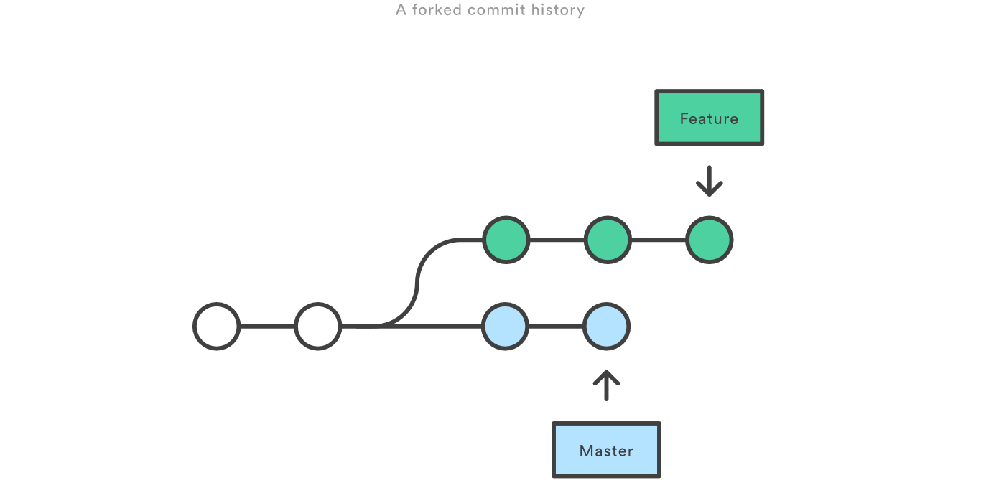
Diverged branch

Slide 20
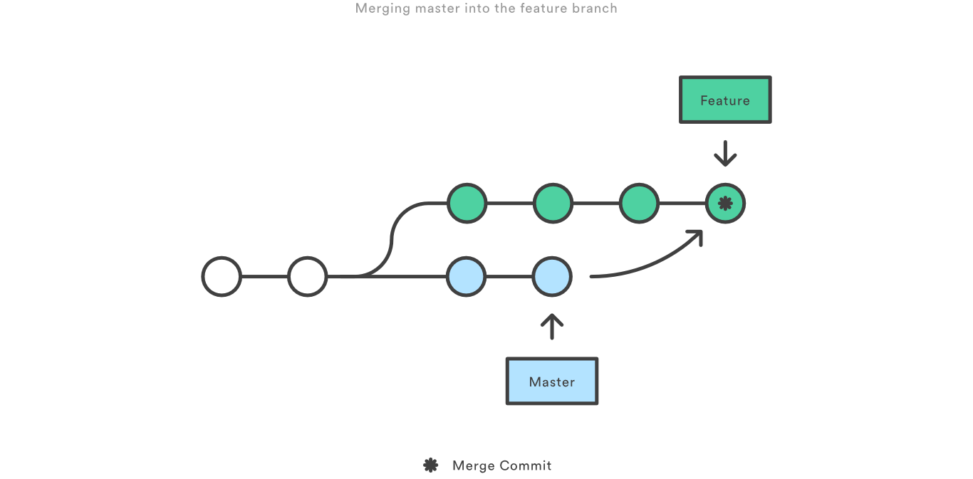
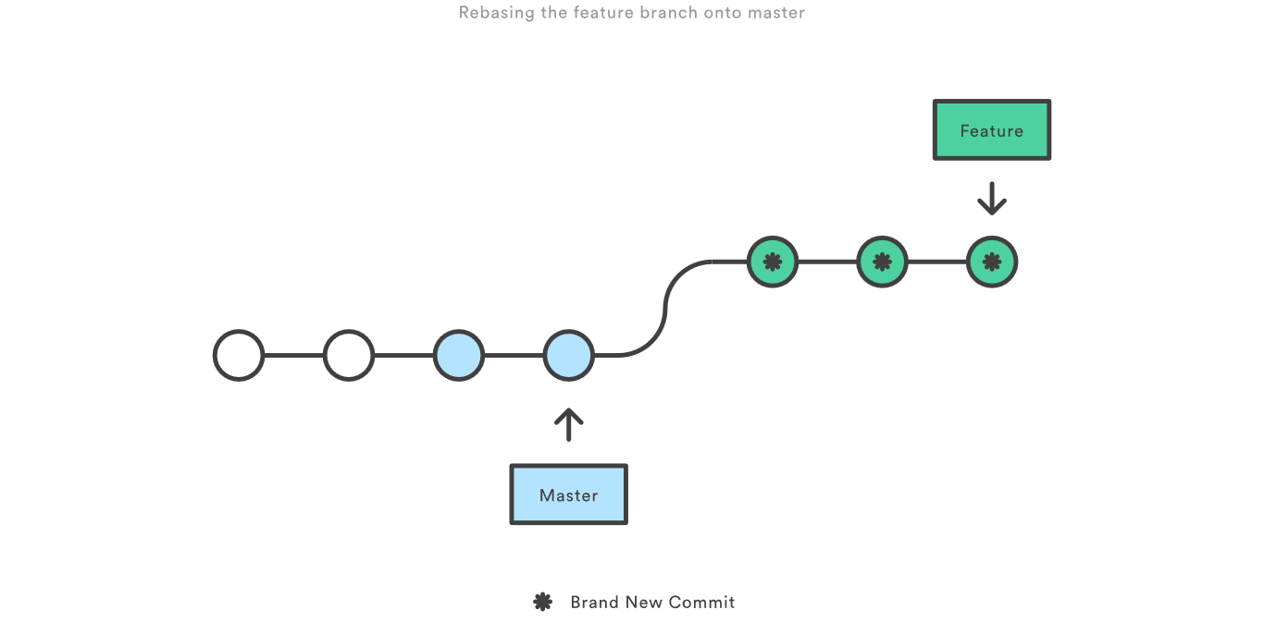
git merge VS git rebase

Slide 21
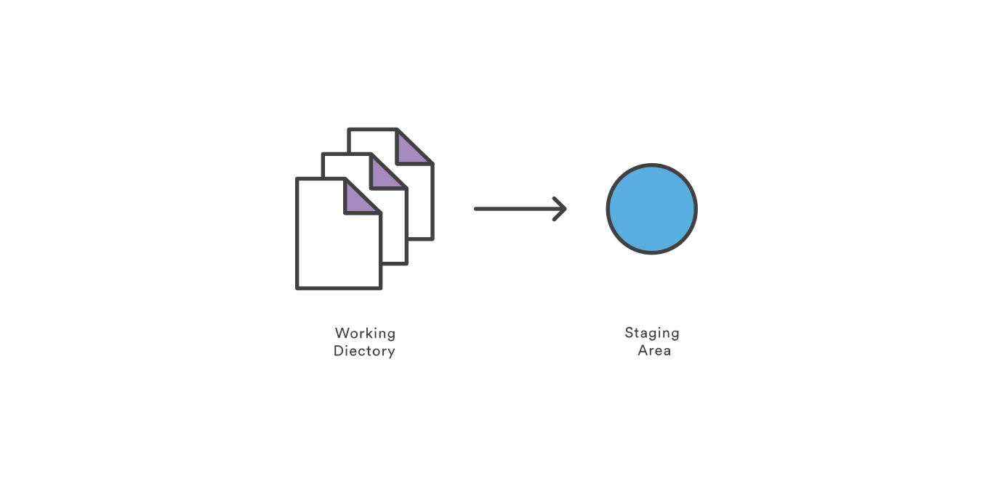
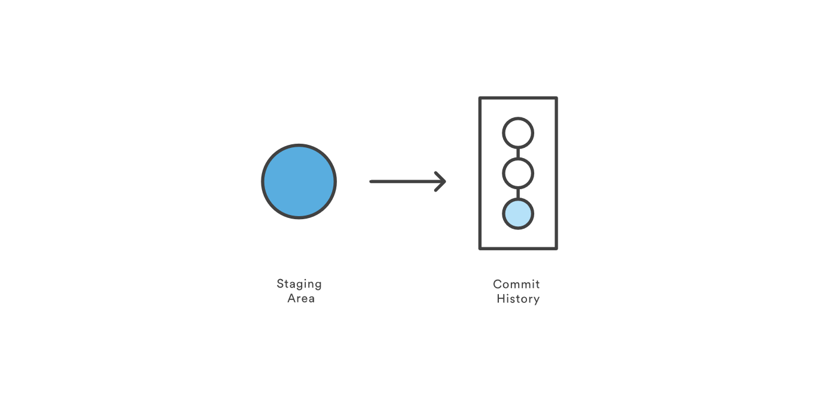
Saving Changes
git add
git commit
Notes:
The git add command adds a change in the working directory to the staging area. However, git add doesn't really affect the repository in any significant way—changes are not actually recorded until you run git commit.
Working directory - The branch that is currently checked out.
Commit - A snapshot of source code & other files for a project

Slide 22
Develop Your Feature
When starting a new feature, you probably want to create a new branch.
Use your favorite editor, and create your feature.
You can make commits to take snapshots of your work as you make changes (always a good idea!)
Notes:
Branch - A path of development. Describes a path of commits.
Commit - A snapshot of source code & other files for a project

Slide 23
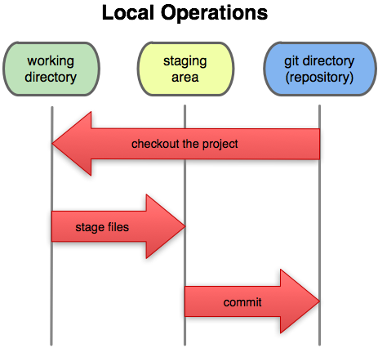
Staging

Slide 24
Staging
When preparing a commit, a file goes through 4 stages:
1) Same as original (the file is unchanged)
2) User editing
3) Staged for commit
(2 and 3 can be repeated many times, the last staged version is committed)
4) Committed.
git add stages a file for commit, or adds a new file to the version control system.
Notes:
The git add command moves changes from the working directory to the Git staging area. The staging area is where you prepare a snapshot of a set of changes before committing them to the official history

Slide 25
Making The Commit
git commit
Will open up an editor* to let you write a commit message describing what you changed. Commit is only made if the message is not empty.
If you want to share your code, or request that it is merged back into master, you should create a pull request.

Slide 26
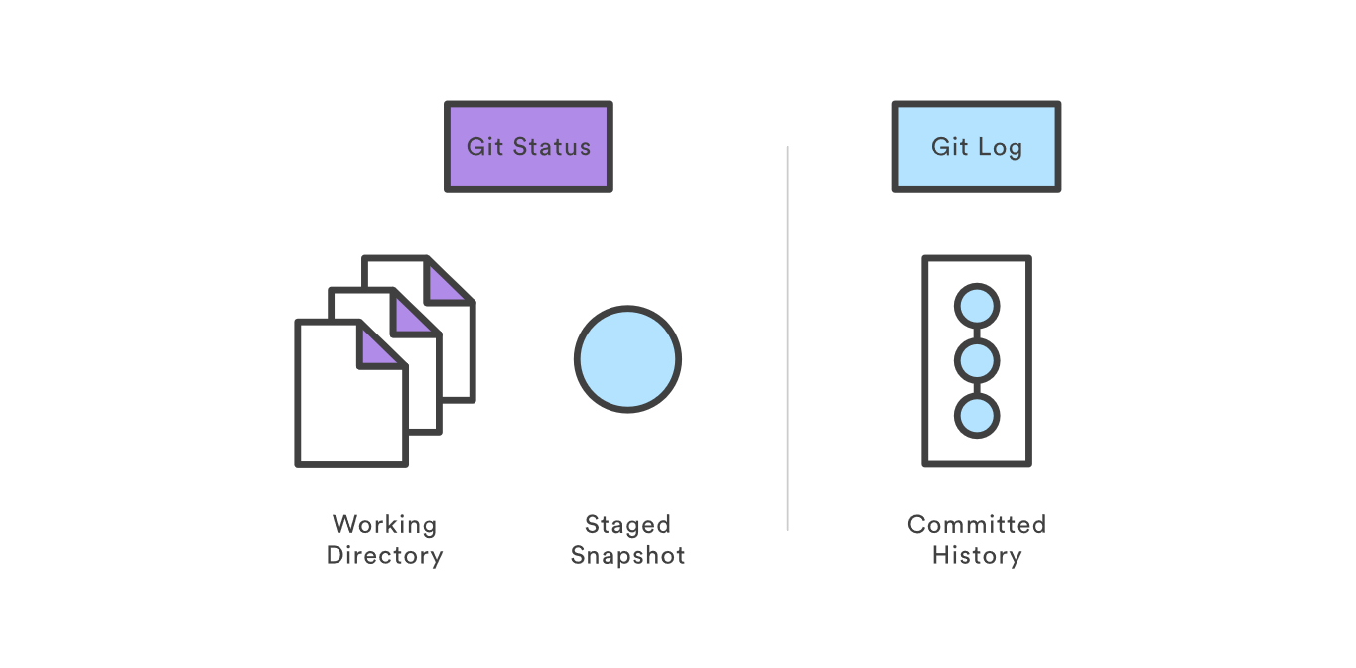
Inspecting a repository
git status
git log

Slide 27
git status
tell you what branch you are on
> git status
# On branch master
# nothing to commit (working dir. clean)
show you how your working directory has changed since your last commit:

Slide 28
git status
> git status
~/programming/FREEDM
# On branch master
# Changes not staged for commit:
# (use "git add <file>..." to update what will be committed)
# (use "git checkout -- <file>..." to discard changes in working directory)
# modified: foo.cpp
# Untracked files:
# (use "git add <file>..." to include in what will be committed)
# bar.cpp
no changes added to commit (use "git add" and/or "git commit -a")
Here foo.cpp is modified and bar.cpp is created

Slide 29
Collaborating
Syncing
Making a pull request

Slide 30
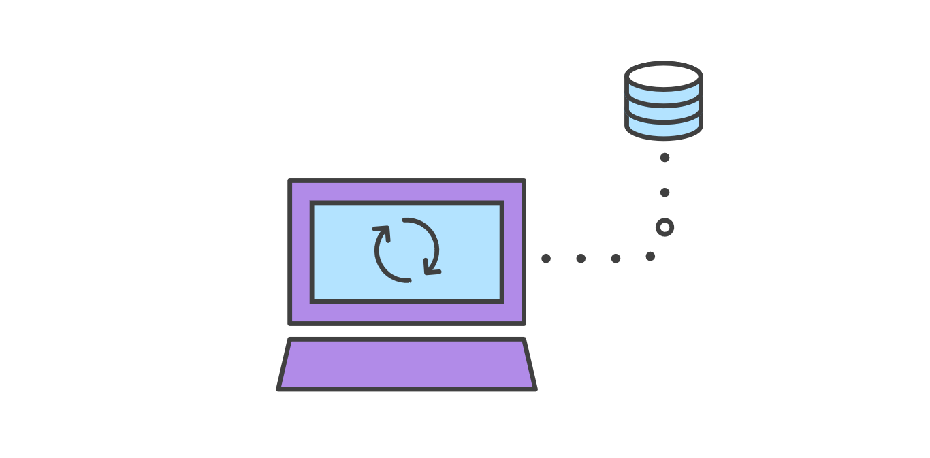
Syncing
git fetch
git pull
git push

Slide 31
git fetch
Synchronize with the upstream development
Imports commits from a remote repository into your local repo
The changes could be reviewed before integrating into the copy of the project.

Slide 32
Updating The Local Copy
Local branches linked to a remote branch do not automatically update when the remote branch is changed. Here’s an example of updating master:
> git fetch orgin
> git checkout master
> git merge origin/master
This switches to master and then looks at origin for any changes. These changes are then merged into your local master
Notes:
Git fetch:

Slide 33
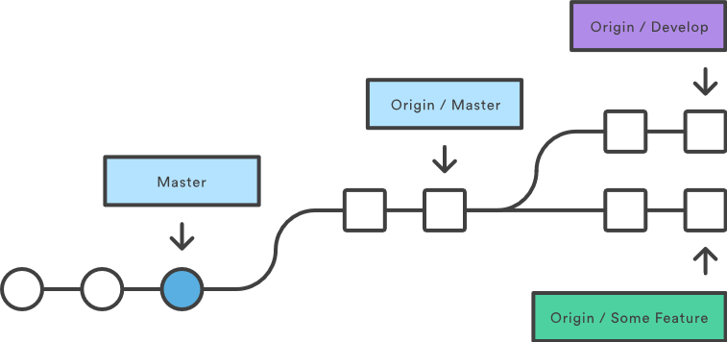
git fetch

Slide 34
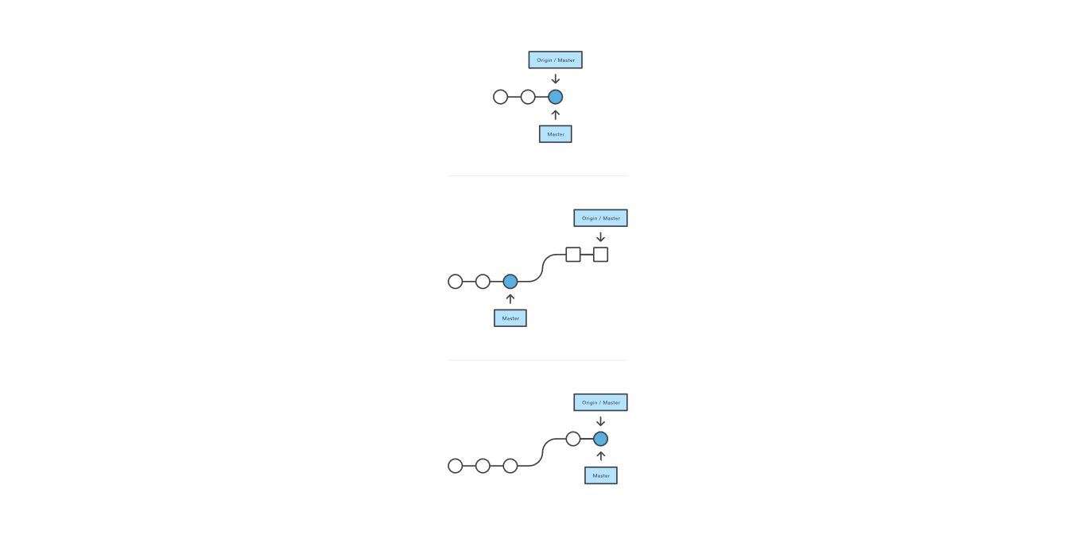
git pull
One single command to merge upstream changes into your local repository

Slide 35
git push
Share your local commits with the rest of the team
Transfer commits from your local repository to a remote repo.
The counterpart to git pull
> git push origin master
Notes:
Publish your local changes to a central repository
Remotes/Origin - Remote sites (ex. Github) that store branches. Origin is the default name for the first remote site.

Slide 36
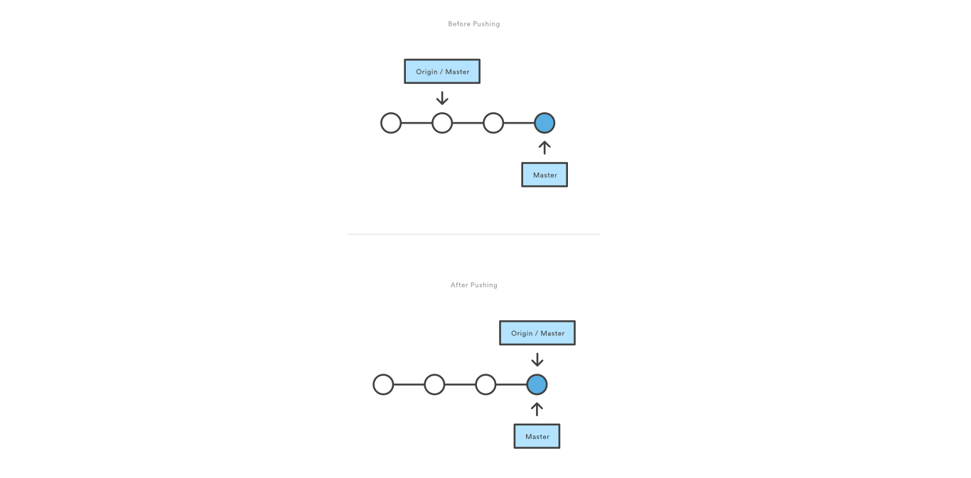
git push
Notes:
Git prevents you from overwriting the central repository’s history by refusing push requests when they result in a non-fast-forward merge.
If the remote history has diverged from your history, you need to pull the remote branch and merge it into your local one, then try pushing again.

Slide 37
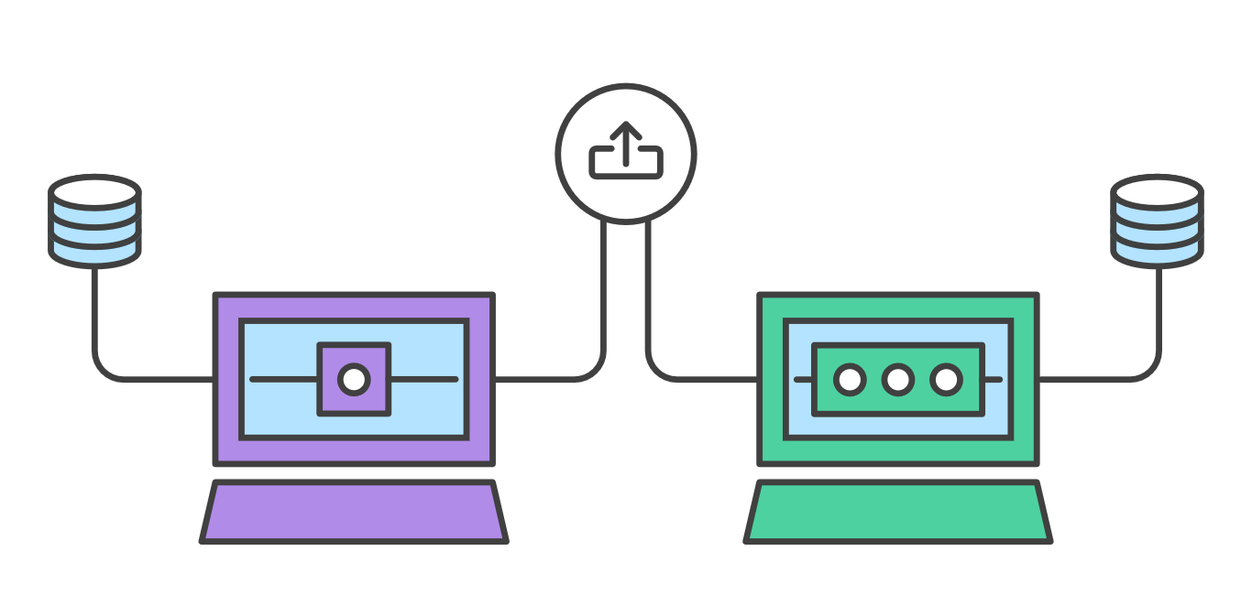
Making a Pull Request
Notes:
Pull requests let you tell others about changes you've pushed to a GitHub repository. Once a pull request is sent, interested parties can review the set of changes, discuss potential modifications, and even push follow-up commits if necessary.

Slide 38
Commands
git checkout
Changes the working directory to a new branch
git commit
Makes a commit
git branch
creates / lists / deletes branches
git push
Copies local changes to the remote repository.
git pull
Copies remote changes to the local repository.

Slide 39
Commands
git fetch
Determines the remote changes. Like pull, but doesn’t copy the changes.
git status/git log
Reminds you what’s going on
git merge
Combines one branch into another.

Slide 40
Acknowledgement
These slides contain material developed and copyright by:
https://www.atlassian.com/git/tutorials/

